Slide 1

Interactive Proof IP = PSPACE
Instructor: Kuan Cheng

Slide 2
Topics
IP for coNP.
IP = PSPACE.

Slide 3



Interactive Proof for ¬ 3SAT

Slide 4




Interactive Proof for ¬ 3SAT

Slide 5


Interactive Proof for ¬ 3SAT

Slide 6

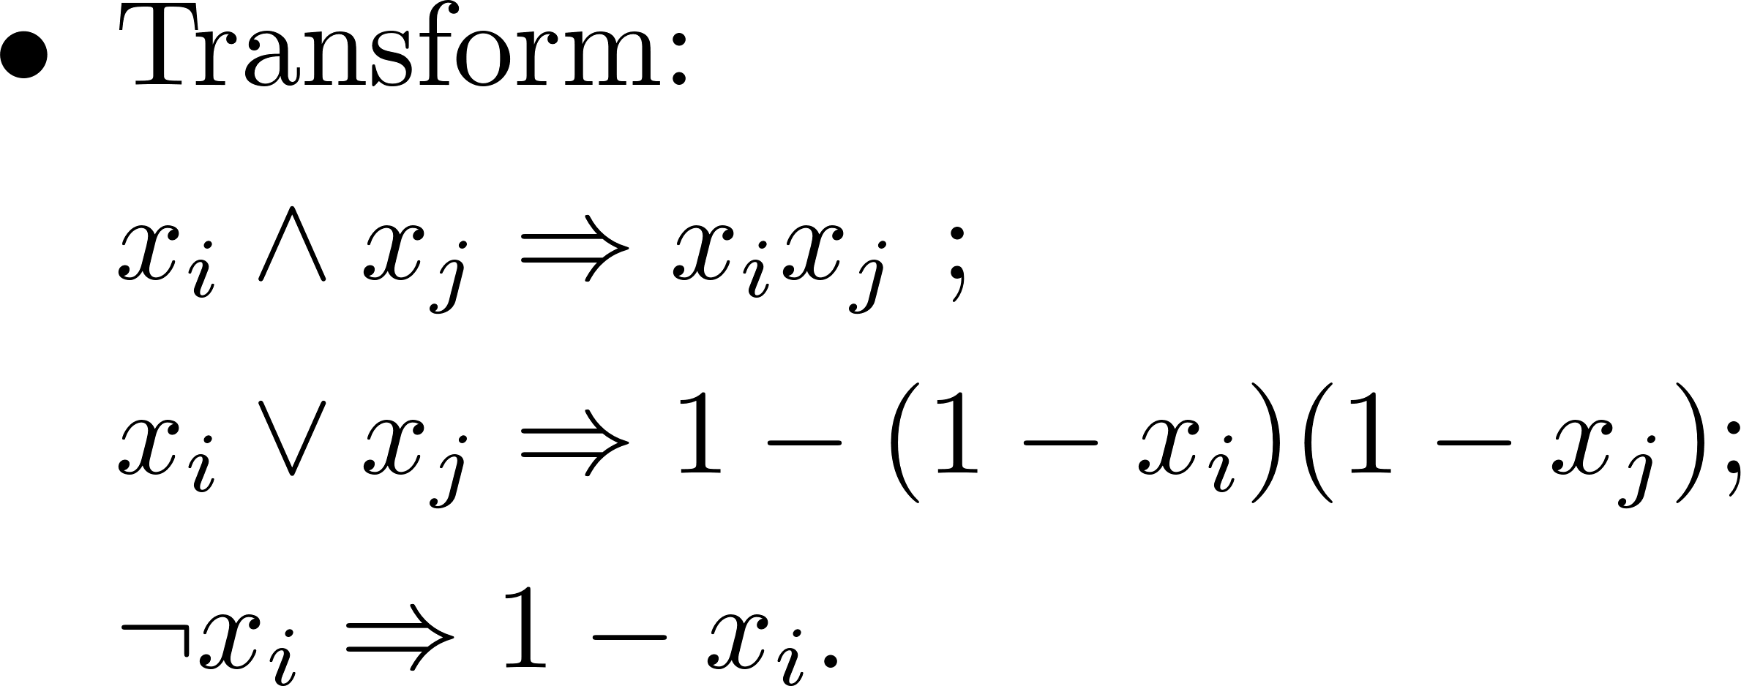

Interactive Proof for ¬ 3SAT

Slide 7



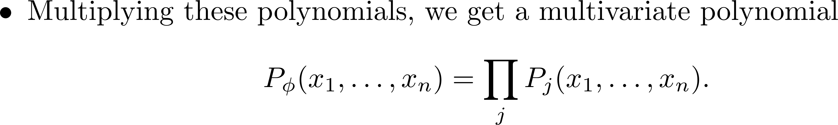
Interactive Proof for ¬ 3SAT

Slide 8




Interactive Proof for ¬ 3SAT

Slide 9




Interactive Proof for ¬ 3SAT

Slide 10



Interactive Proof for ¬ 3SAT

Slide 11





Interactive Proof for ¬ 3SAT

Slide 12




Sumcheck protocol

Slide 13
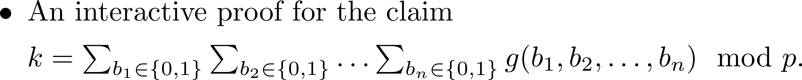



Sumcheck protocol

Slide 14

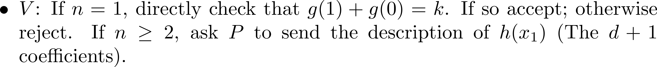

Sumcheck protocol

Slide 15
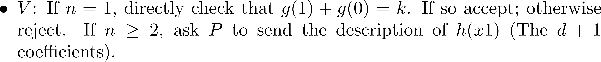
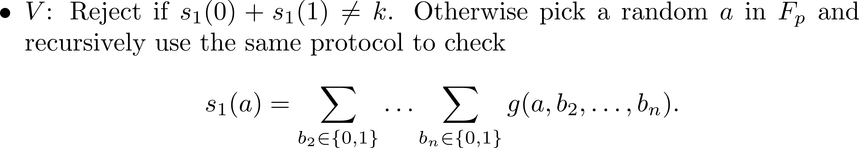
Sumcheck protocol

Slide 16


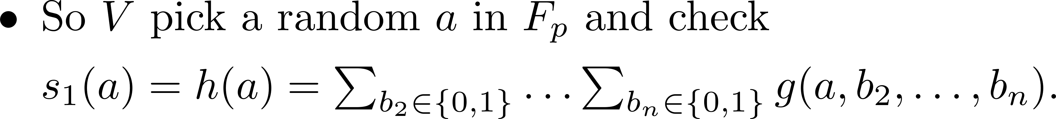

Sumcheck protocol

Slide 17




Sumcheck protocol

Slide 18





Sumcheck protocol

Slide 19




Sumcheck protocol

Slide 20



Sumcheck protocol

Slide 21




Sumcheck protocol

Slide 22




Generalize to TQBF

Slide 23




Protocol for TQBF

Slide 24





Protocol for TQBF

Slide 25




Protocol for TQBF

Slide 26

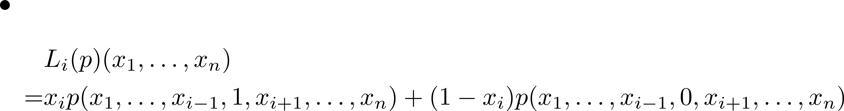


Protocol for TQBF

Slide 27




Protocol for TQBF

Slide 28





Protocol for TQBF

Slide 29


Protocol for TQBF

Slide 30





Protocol for TQBF

Slide 31




Protocol for TQBF

Slide 32




Protocol for TQBF

Slide 33




Protocol for TQBF

Slide 34



Protocol for TQBF

Slide 35



Protocol for TQBF

Slide 36
Multi-Prover Interactive Proof
Previously, there is one prover and one verifier.
Can generalize to more than one prover.
Provers may communicate before the protocol to fix a strategy, but cannot communicate during the protocol (cannot collaborate).
Similar to interrogating two suspects in separate rooms.

Slide 37
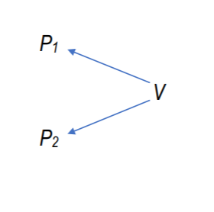
Multi-Prover Interactive Proof
This leads to the class MIP.
Turns out for MIP, two provers is equivalent to poly(n) provers.
MIP=NEXP (BFL90)

